Slide 1
HANDS-ON TRAINING PROGRAMME ON WEB DEVELOPMENT
R. Vikas
M. Soorya Prakash

Slide 2
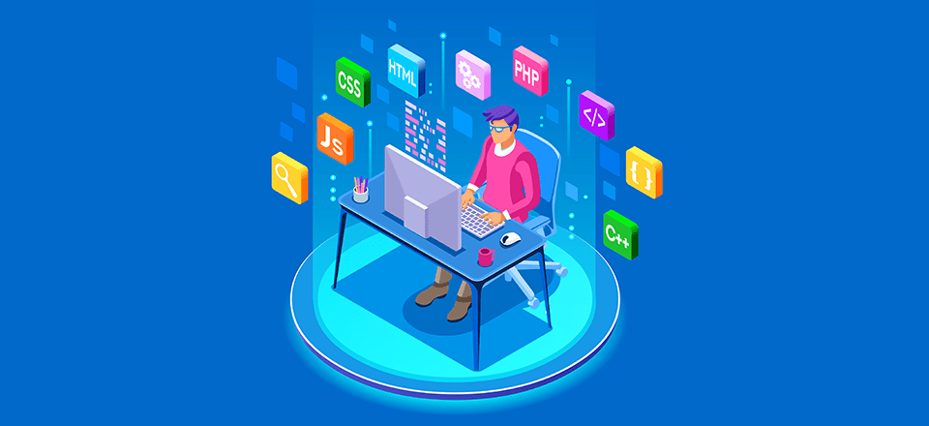
What is Full Stack ?
"Full stack" refers to the development of both the front-end (the user interface and visible parts of an application) and the back-end (the server, databases, and logic that make an application work) of software or a website.

Slide 3
FULL STACK
FRONT END
BACK END
DATABASE
The frontend is the part of a website or application that users see and interact with, encompassing all visual and interactive elements like the layout, design, text, images, buttons, and navigation menus.
The backend, also known as the server-side, refers to the part of a software application that is not directly accessible to users. It handles the logic, data processing, and communication between the frontend (user interface) and the database.
A database is an organized collection of structured information, or data, typically stored electronically in a computer system. Its primary purpose is to store, manage, and retrieve data efficiently and securely.

Slide 4
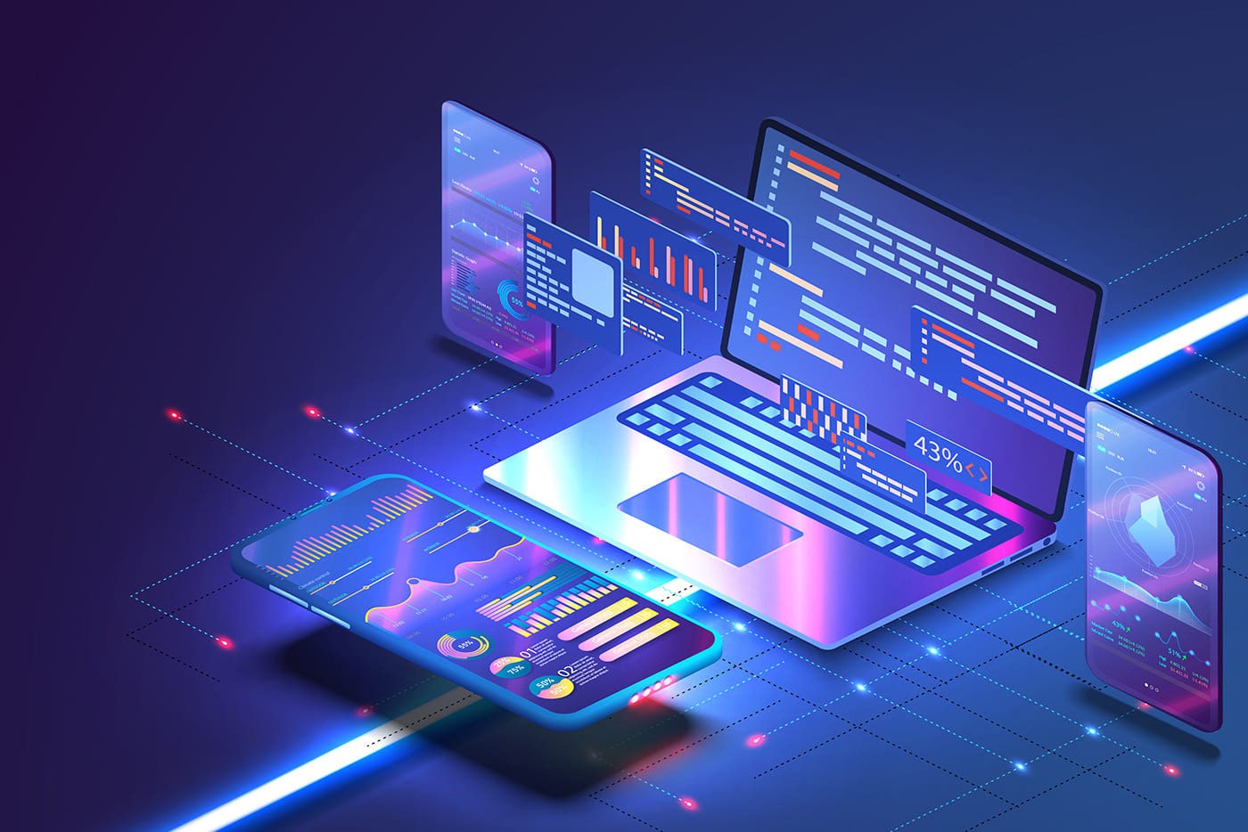
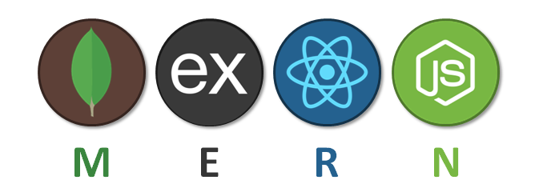
MERN STACK

Slide 5

Mongo db
ongoDB is an open-source, NoSQL document database. Unlike traditional relational databases that store data in tables with predefined schemas, MongoDB stores data in flexible, JSON-like documents.

Slide 6

Express js
xpress.js, often referred to simply as Express, is a fast, unopinionated, and minimalist web application framework for Node.js. It provides a robust set of features to develop web and mobile applications and APIs.

Slide 7

React js
eact.js (often referred to simply as React) is a declarative, component-based JavaScript library for building user interfaces. It was developed and is maintained by Facebook.

Slide 8

Node js
ode.js is an open-source, cross-platform JavaScript runtime environment that allows developers to execute JavaScript code outside of a web browser. Traditionally, JavaScript was limited to client-side scripting within browsers for interactive web pages. Node.js extends the utility of JavaScript by enabling its use for server-side and networking applications, command-line tools, and even desktop applications

Slide 9
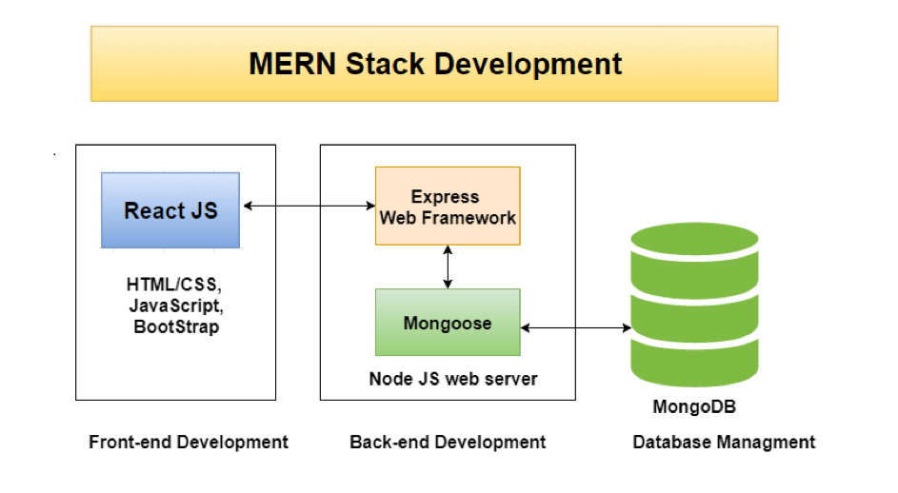
MERN WORK FLOW

Slide 10
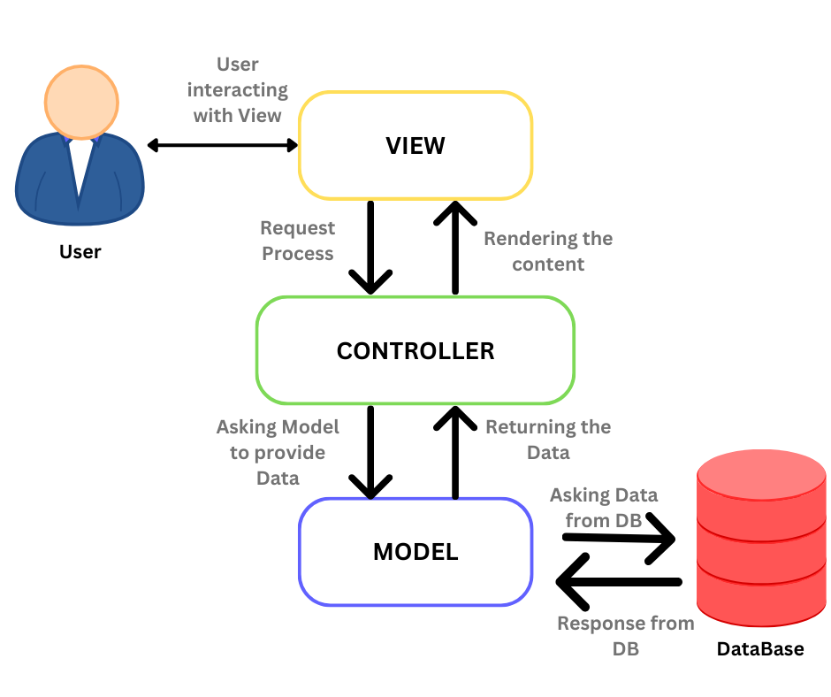
MVC ARCHITECTURE

Slide 11


HANDS-ON
PROJECT

Slide 12


Thank You
Vikas R
Soorya Prakash M
Web developer
Web developer

